Slide 1
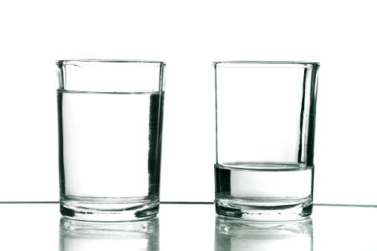
Health Inequalities
NI Health & social care inequalities monitoring system (HSCIMS)
Caolan Laverty
Statistician (NISRA)
Department of Health NI

Slide 2

NI Health & Social Care Inequalities Monitoring System
Regional level inequality gaps
Inequalities within Trust areas
Inequalities within Council/LGD areas
Area profiles (e.g. DEA, localised studies)
Life expectancy decomposition (i.e. mortality causes of life expectancy gaps)

Slide 3
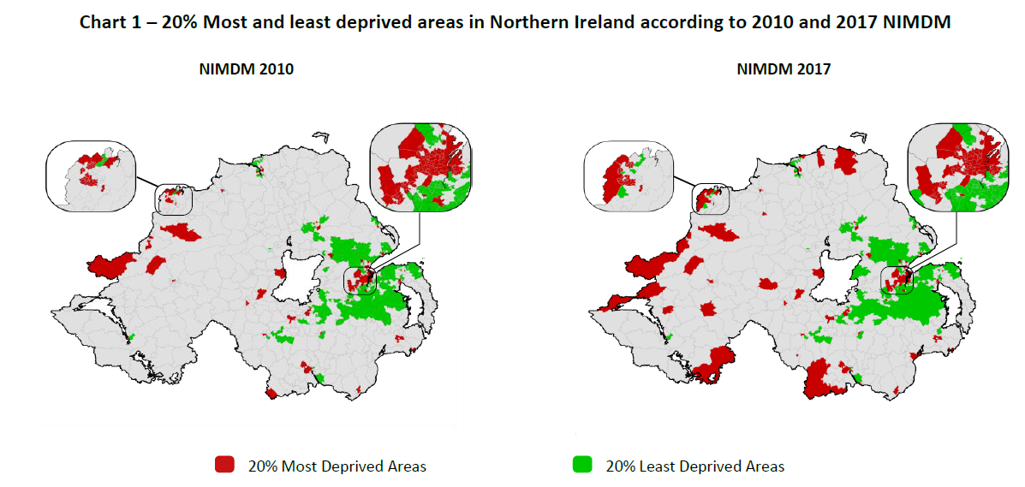
NI Multiple Deprivation Measure

Slide 4
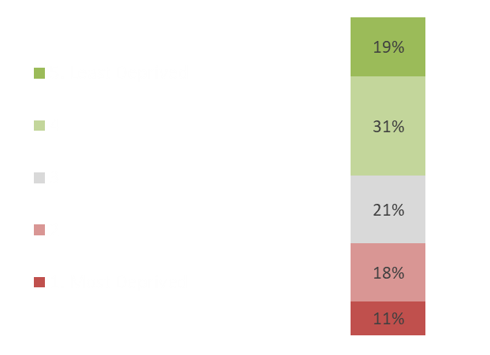
NI Multiple Deprivation Measure – Northern Trust
Northern Trust areas by NIMDM17 quintile
Northern Trust areas in NI’s 20% Most Deprived

Slide 5
Deprivation Inequality Gaps in the Northern Trust
Northern Trust 20% Most Deprived

Slide 6
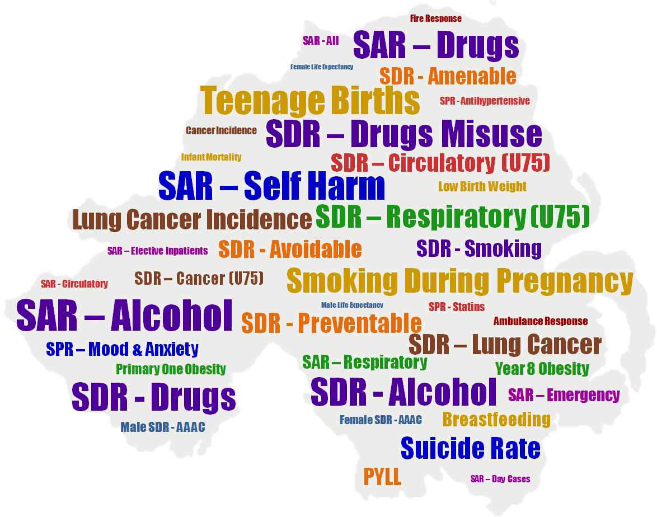
Largest Inequality gaps in Northern Ireland

Slide 7
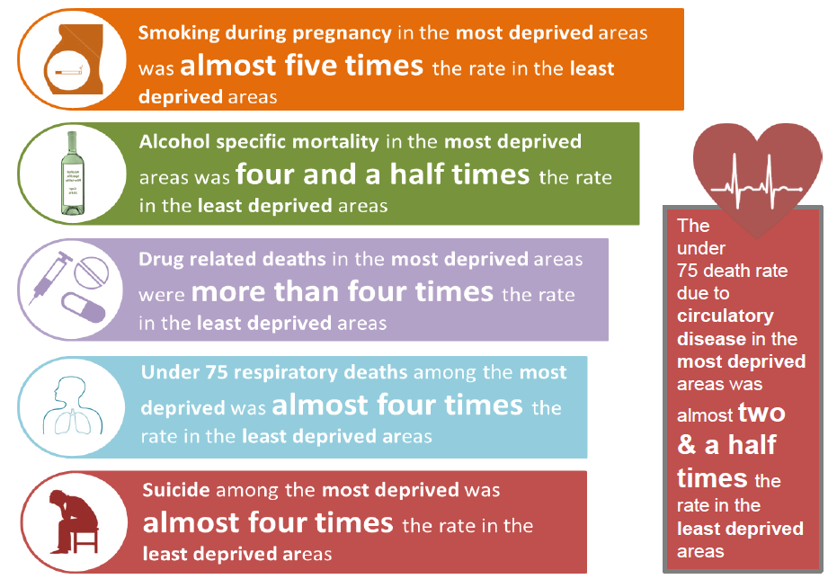
Largest Inequality gaps in Northern Ireland

Slide 8
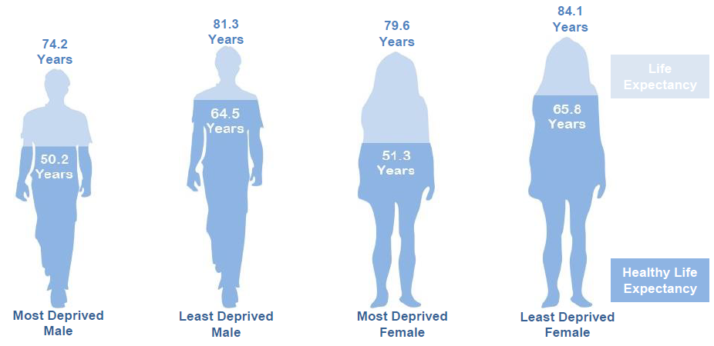
Largest Inequality gaps in Northern Ireland

Slide 9
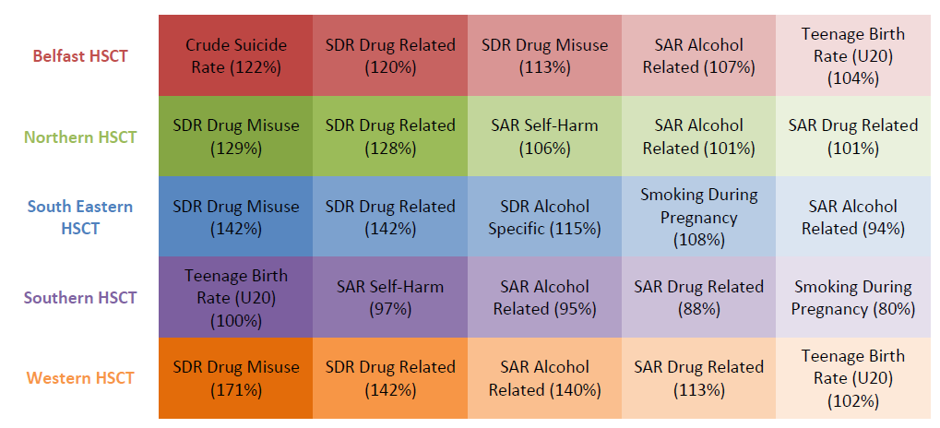
Largest Inequality gaps in Trusts

Slide 10
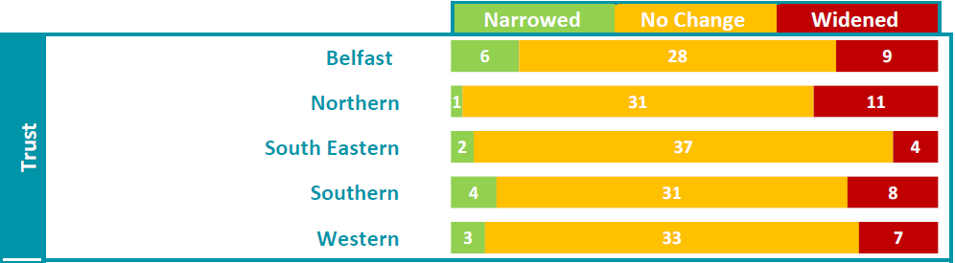
Changes to Inequality gaps in Trusts

Slide 11
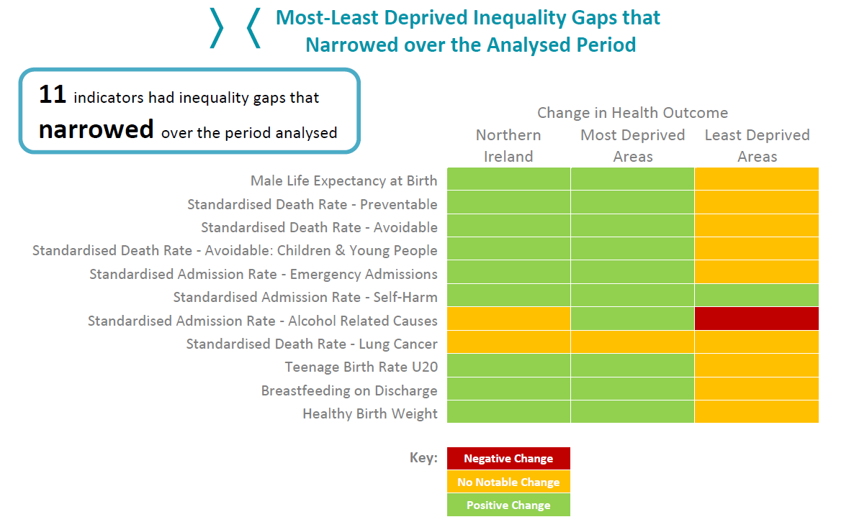
Changes to Inequality gaps in Trusts

Slide 12
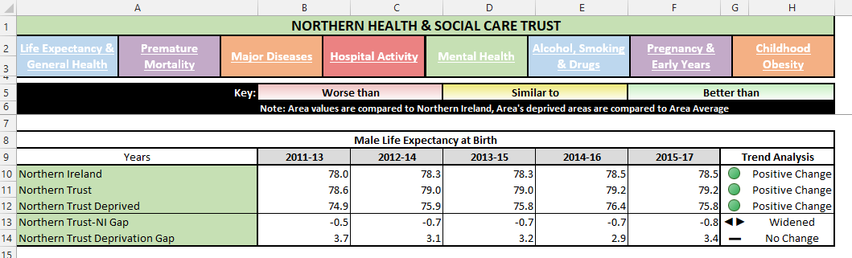
Changes to Inequality gaps in Trusts

Slide 13
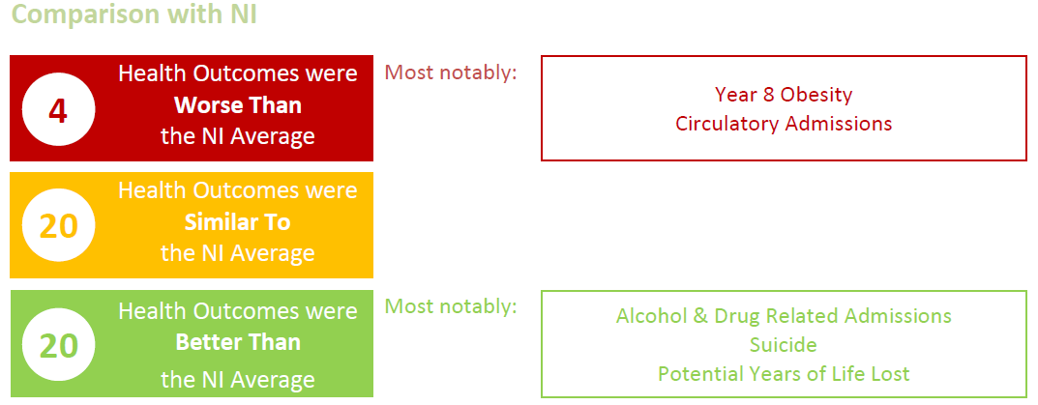
How does Northern Trust compare to NI ?

Slide 14
Summary - Health Inequalities in the Northern Trust
Those living in the most deprived areas of the Northern Trust are almost two and a half times as likely to die from drugs classified under the drugs misuse act, than the average Northern Trust resident.
Hospital admissions as a result of self-harm among the Northern Trusts most deprived are more than double the Trust average.
Alcohol related admissions among the most deprived are double the Trust average.
The most deprived Trust residents are twice as likely to be admitted to hospital for a drug related condition.

Slide 15
Reports and contact information
https://www.health-ni.gov.uk/topics/dhssps-statistics-and-research/health-inequalities-statistics
Caolan.Laverty@health-ni.gov.uk
Healthinequalities@health-ni.gov.uk

