Slide 1
NICHI Conference
NICHI 8th ANNUAL CONFERENCE
Wednesday 12th February 2020

Slide 2
AGENDA
9.30 am Registration and Refreshments
10.00 am Welcome & Entertainment
10.30 am Keynote Speaker: Department Of Health
11.00 am Comfort Break
11.10 am Orbit Dance Group
11.20 am Arts Care Workshop
12 noon NICHI update
12.10 pm Q&A Evaluation
12.20 pm Closing Remarks
12.30 pm Lunch

Slide 3
Welcome!

Slide 5
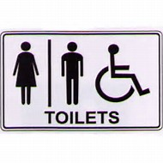
Housekeeping
Refreshments
Toilets
Fire Exit
Mobile Phones – Silent
Loop System
– Turn Hearing Aids to ‘T’ coil

Slide 6
Keynote Speakers
Caolan Laverty, Deputy Principal Statistician,
Public Health, Information and Research Branch,
Department of Health
Dolores Palmer, Deputy Principal, Health
Development Policy Branch,
Department of Health

Slide 7
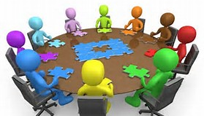
Arts Care Workshop
Orbit Dance Performance
Interactive Workshop

Slide 8
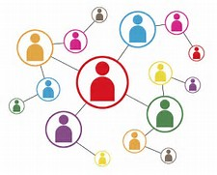
Networks Involving Communities In Health Improvement
NICHI Update

Slide 9
Aim - NICHI Project
To strengthen links between PHA and local communities in order to support local communities,
through a community development approach,
to address health and social wellbeing issues and reduce health inequalities through :
signposting,
building capacity and
strengthening local accountability to develop healthy, sustainable communities

Slide 10
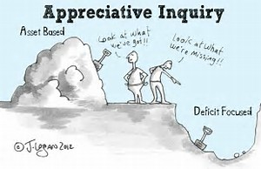
Communities Improving Health
Aim
‘to support communities who have identified a local health and social well-being need or who are aspiring to work towards addressing health and social wellbeing issues’.

Slide 11
NICHI Model

Slide 12
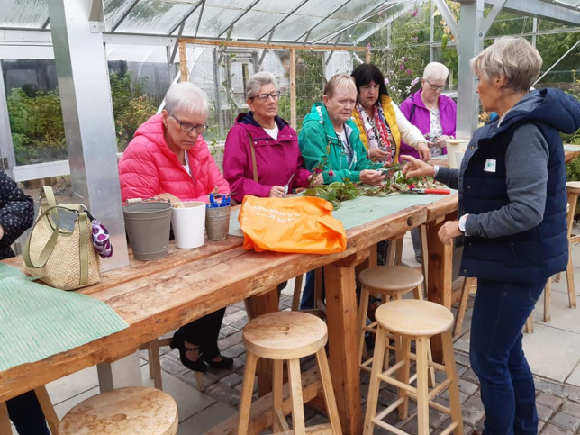
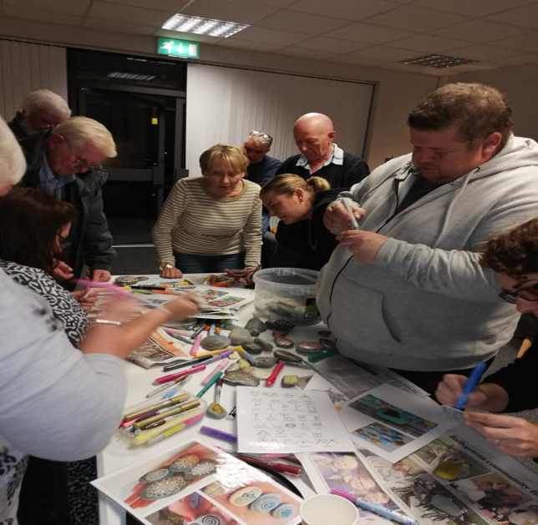
NICHI Model Groups
Ballyclare Women’s Group
-Art and Craft workshop & Self-Care
Carrickfergus Cornerstones
-Physical Activity & Winter Wellbeing

Slide 13
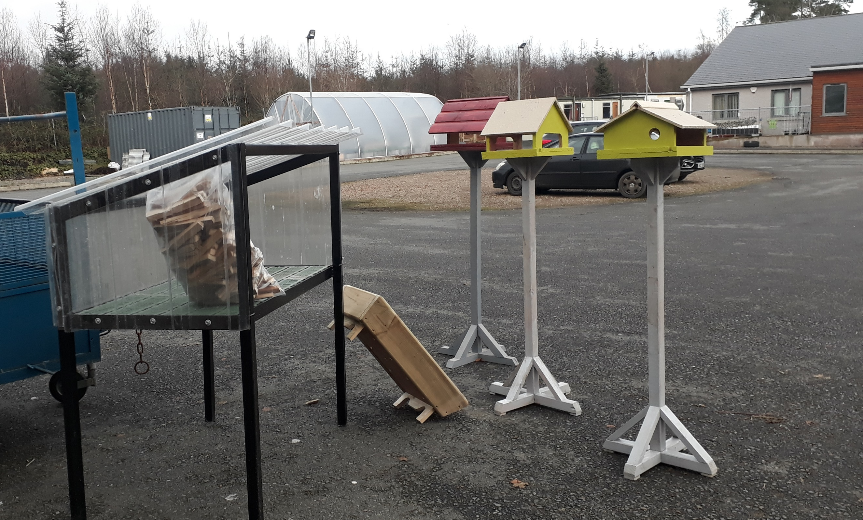
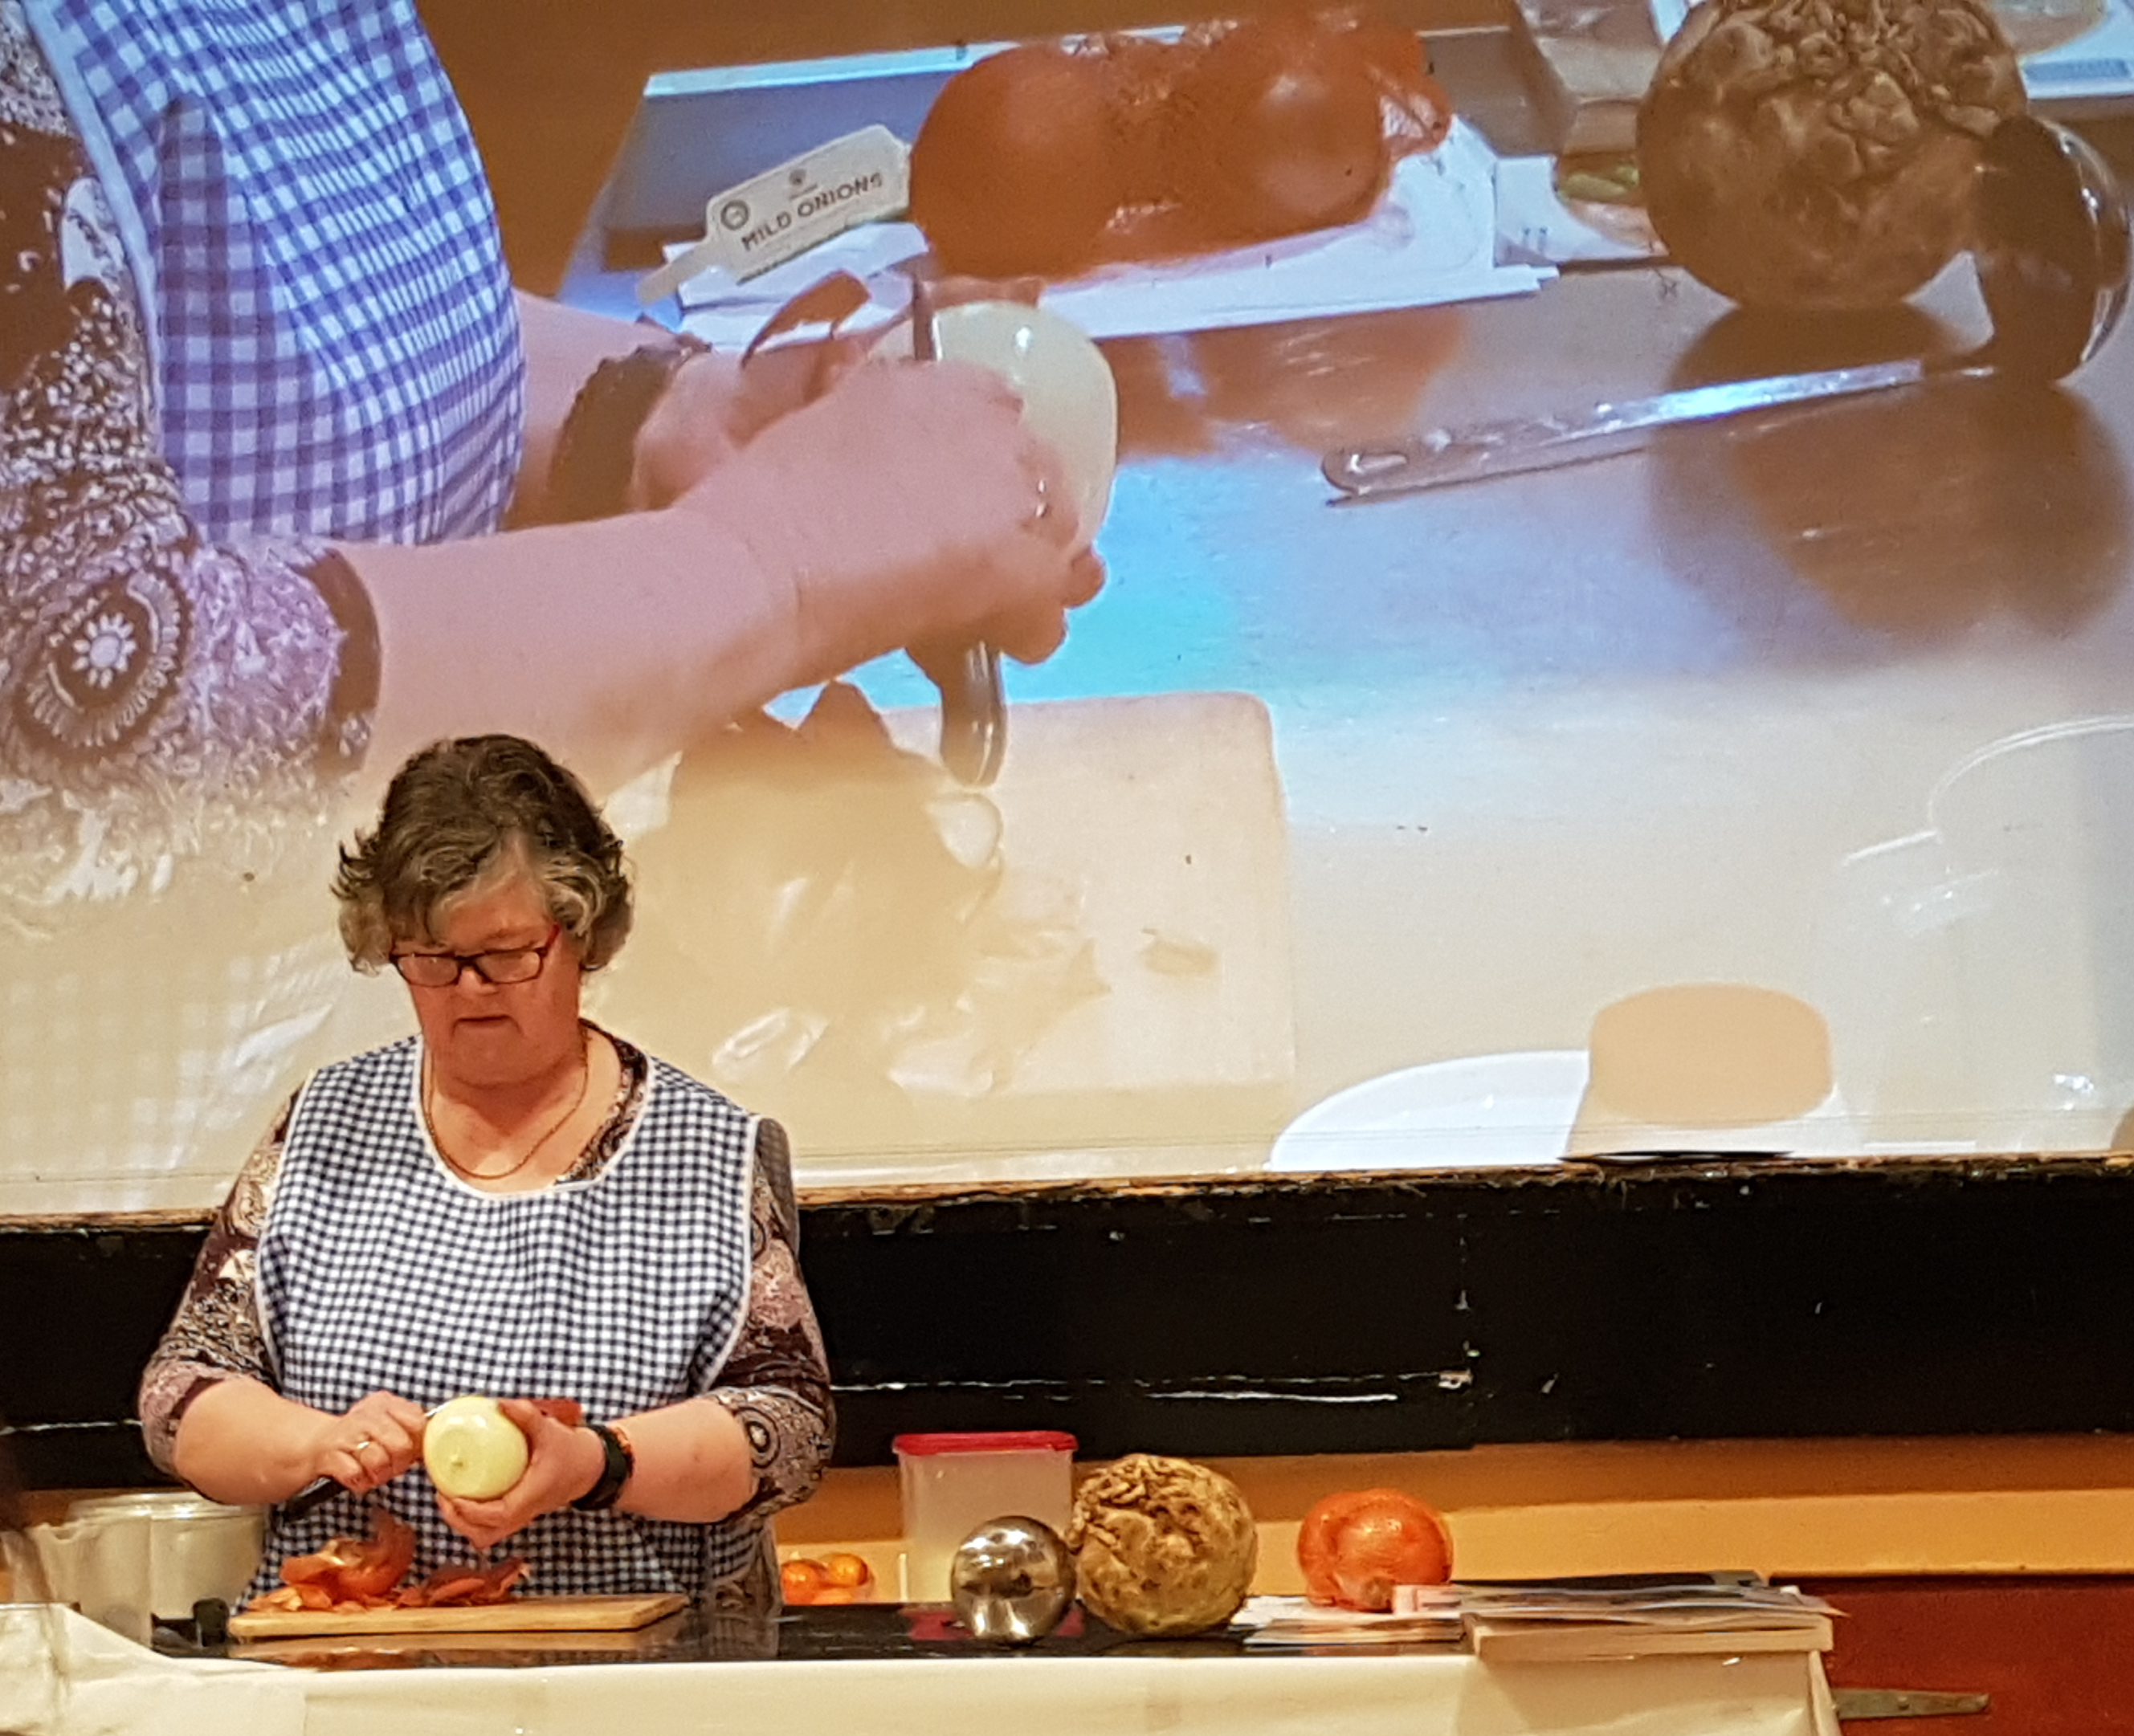
NICHI Model Groups
Pomeroy Men’s Shed
-Physical & Mental Wellbeing
Knocknagin Hall Committee
-Physical Activity & Healthy Eating

Slide 14
NICHI Model Groups
Group
-Physical & Mental Wellbeing
Group
-Physical Activity & Healthy Eating

Slide 15
Health Alliance www.healthallianceni.com
To provide a mechanism for community, voluntary and statutory sectors to:
network,
share information and best practice,
engage in evidence based health improvement,
access training and capacity building opportunities and
contribute to shaping the health improvement agenda
Provides a central location for all health improvement related information
Serves as an interactive platform to enable information exchange between community, voluntary and statutory sectors
Currently 287 members

Slide 16
Sign up today to our Health Alliance website: http://healthallianceni.com/
Sign up to become a member
for free and receive a regular e-zine with Health and well being info & events across Northern Locality area

Slide 17
NICHI Highlights 19/20
Facilitated two Social Model Of Health Training Workshops
Developed and Launched NICHI Model Tool Kit
Worked with fifteen groups through the NICHI Model project
Hosted Good Practice Visit to Cloughmills ‘Incredible Edibles’
Hosted NICHI Model Networking Event
Sent Health Related Info via Ezine to members every 2 weeks

Slide 18
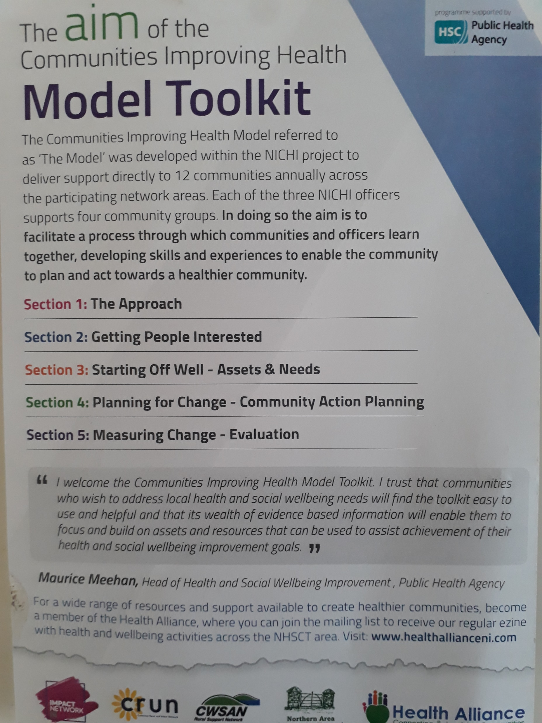
NICHI Model Groups

Slide 19
NICHI Officers Contact Details
Veronica McKinley
Ballymena, Ballymoney, Larne and Moyle
T: 028 2177 2100
E: health@nacn.org
Anita Kelly
Magherafelt, Cookstown and Coleraine
M: 075 4063 5862
E: healthalliance@cwsan.org
Pamela McCelland
Antrim, Newtownabbey and Carrickfergus
T: 028 9447 8645
E: pamela@impactnetworkni.org

Slide 20
Q & A Session

Slide 21
Closing Remarks

Slide 22
Remember to complete and return Evaluation Forms
Enjoy your LUNCH
Safe Home!

